Slide 1
A survey on Control Configuration Selection and New Challenges in Relation to WSAN
Miguel Castaño Arranz Luleå University of Technology
Wolfgang Birk Luleå University of Technology
George Nikolakopoulos Luleå University of Technology

Slide 2
Outline
Introduction to Control Configuration Selection
Families of Methods for Control Configuration Selection
Desirable Properties of Control Configuration Selection Methods
Concluding remarks.

Slide 3
Introduction to Control Configuration Selection

Slide 4
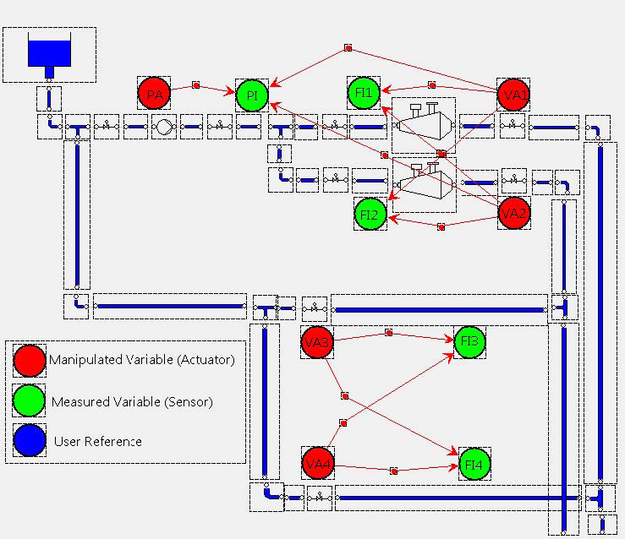
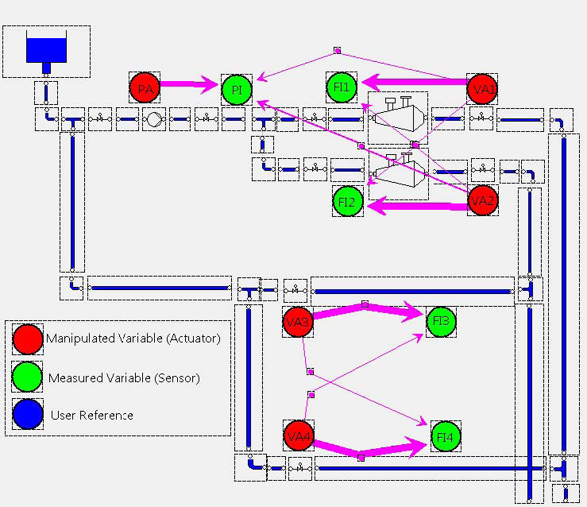
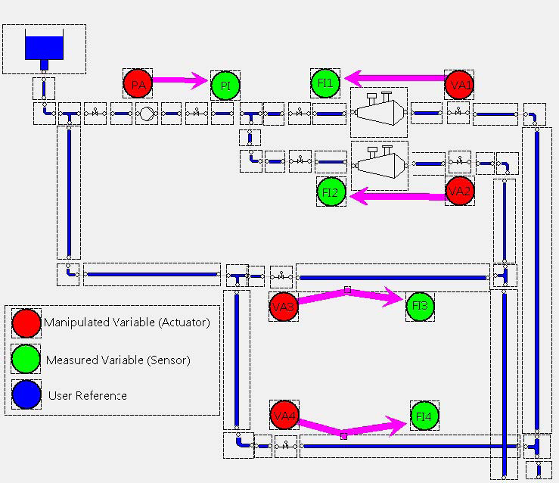
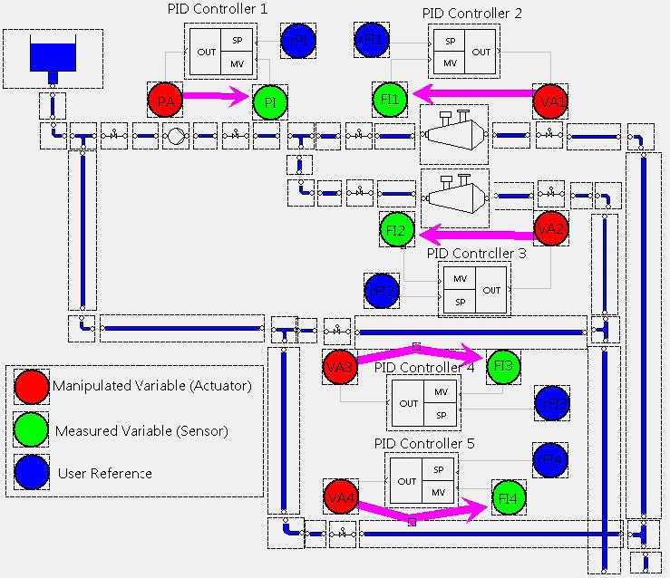
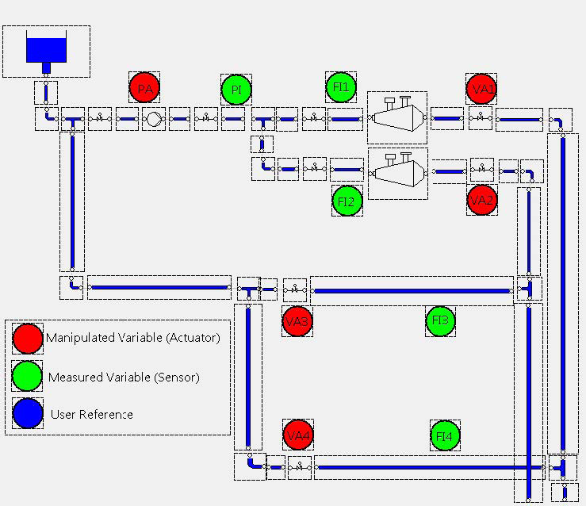






A procedure for control design of complex processes
Subset of sensors and actuators
(IO Selection)
Model
Control Configuration
Performance specification
Controller parameters
Implemented controller
Example: Stock Preparation Plant at SCA Obbola AB, Sweden
Notes:
This slide shows a usual procedure for control design in industry processes.
1.- A subset of the available measurements and actuators are selected for control, using criteria which is criteria like controllability and observability.
2.- A model is created, where each red arrow in the figure represent a model of an input-output interconnection.
3.- A control configuration is selected, which is based on selecting a reduced model formed by the most important input-output interconnections. Controllers are then deployed based on the reduced model.
4.- Performances specifications are placed in terms of e.g. sensitivity functions.
5.- The controller parameters are design with the use of e.g. PID tuning methods.
6.- The controller is implemented and tested.
This paper focuses on the control configuration selection step.

Slide 5
Control Configuration Selection
Problem definition:
Determine a control configuration of least complexity that yields a sufficient closed-loop performance for the complete multivariable system, without designing the controller parameters.
The control configuration complexity is quantified as the number of non-zero elements in the transfer function of the controller.
Why not designing a full MIMO controller?
Full multivariable controllers have the largest achievable performance. However:
Decentralized controllers are simpler to design, implement and maintain.
Decentralized controllers are more robust to plant failures.
There is a trade-off between simplicity and robustness Vs achievable performance.

Slide 6
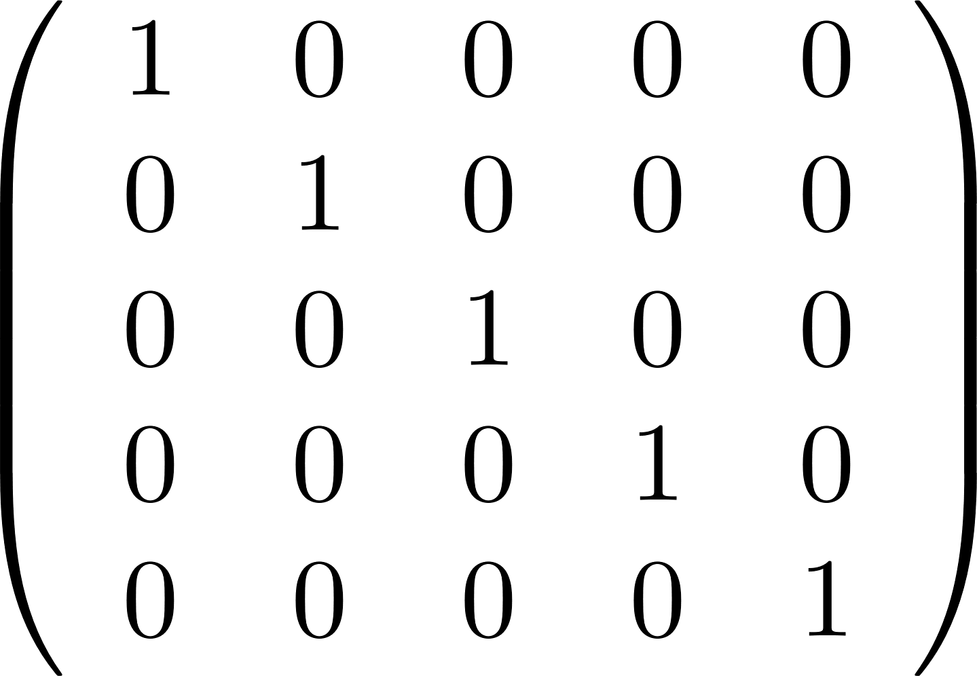
Control Configuration Selection
Controller configuration (definition)
The controller configuration of a controller for a multivariable system with m inputs and n outputs is and l x m binary connection matrix which has at least one element different from zero in each row and each column.
Designing the control configuration is choosing the combination of inputs and outputs which are sued for control.
Decentralized Controller
Plant
r
e
u
y
Controller Configuration:
-
+

Slide 7
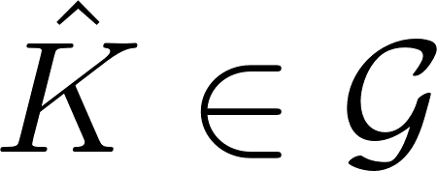
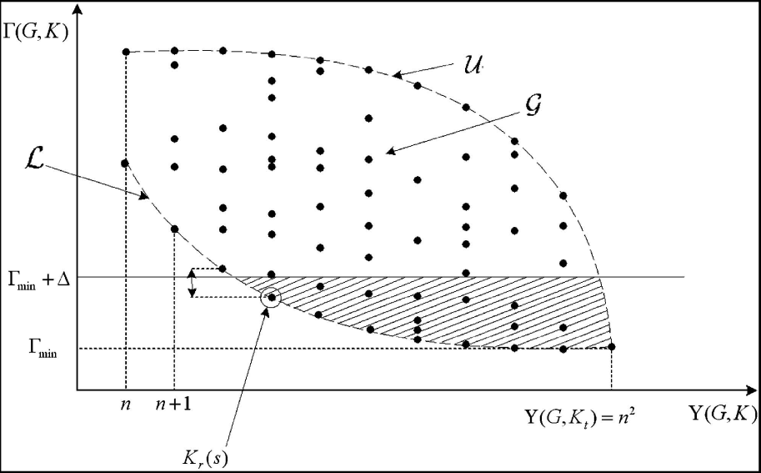

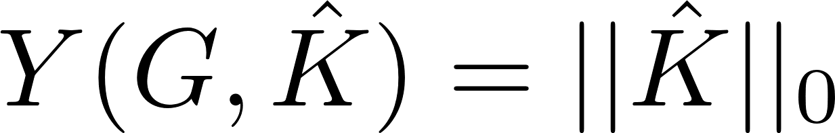
Control Configuration Selection as optimization problem
is a binary matrix which represents the structure of the controller.
Γ is an achievable performance function that has to be minimized
Γ_{min} is the minimum (best) achievable performance
Y is the complexity of the configuration. Ideally:
Clearly, Control Configuration Selection is a problem of combinatorial nature.
Approximations can be sought to make the problem convex.
Notes:
Each of the dots represents a possible configuration, being the problem of combinatorial nature.
The point at the bottom right is the most complex configuration (full multivariable controller), which has the best (minimum) achievable performance.
At the left, there are the decentralized controllers, which have the maximum simplicity.
The problem is to find a trade-off and design a simple controller with acceptable performance.

Slide 8
Families of methods for Control Configuration Selection

Slide 9
Families of methods for Control Configuration Selection
Interaction Measures using Relative Gains
Heuristic tools only for decentralized control and provide indications about stabilizability.
Gramian-based Interaction Measures
Heuristic tools for the design of sparse configurations
Methods based on Optimization Schemes
Can be based on integer programming on in convex programming through the use of approximations.h
Plantwide Control
Methods for the reconfiguration of the control structures
To incrementally increase the complexity of an existing configuration in order to improve performance.

Slide 10

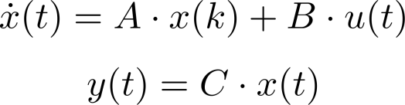

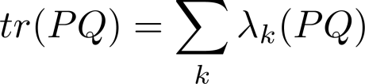
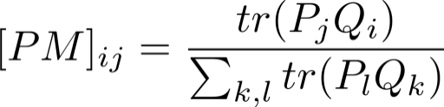
Example of CCS methods> Gramian-Based Interaction Measures
Idea: Determine the most significant input/output channels and select them for the controller design.
P and Q are the controllability and observability gramians.
Gramians widely used to quantify the importance of the system’s dynamics..
The eigenvalues of the product PQ quantifies the connection of the input and output spaces through the state space.
The sum of the eigenvalues (trace) of PQ can be used to quantify system dynamics.
Those channels G_{ij} with largest value of tr(PjQi) are the most important interconnections.
tr(PQ) is the indicator used by the gramian/based interaction measrure named Participation Matrix.

Slide 11
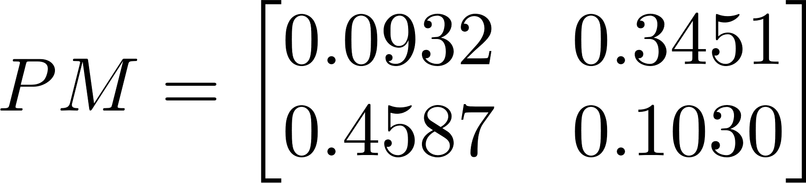
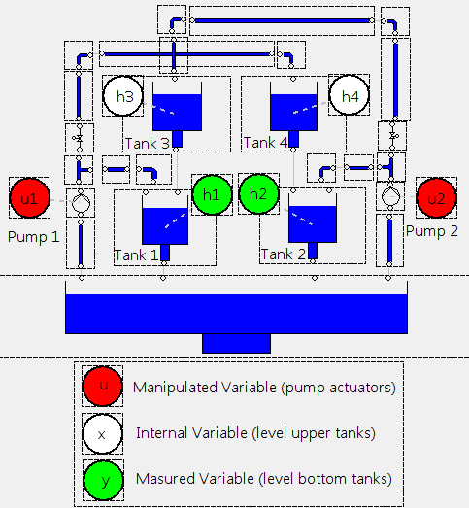
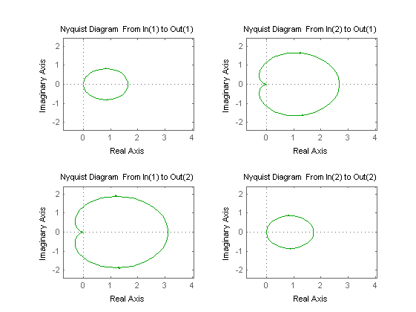
Participation Matrix example on a 2x2 process
The sum of all the elements in PM are always 1
In this example, the off-diagonal elements add up to 0.8. This means that an off-diagonal decentralized controller would consider 80% of the process dynamics.
Configurations with a contribution larger than 0.7 are expected to derive in satisfactory performance.
The PM has a direct relationship with the Nyquist diagram. Those channels with larger area in the Nyquist diagram are the most significant.

Slide 12
Desirable Properties of Control Configuration Selection Methods

Slide 13
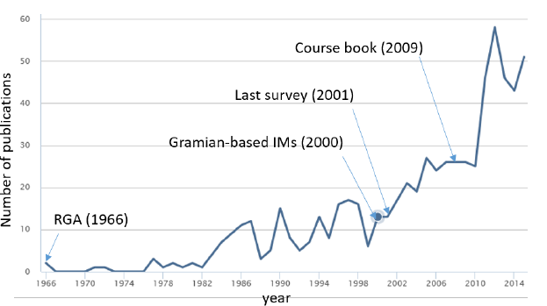
Desirable Properties of a Control Configuration Selection methods
Despite the increasing number of publications on CCS, the terminology in the field is still not very well-defined. Neither are the properties a CCS method should have.
This paper introduces and discusses a set of desirable properties for CCS methods simply enumerated here:
P1: Well-founded P6: Independent from pre-defined structures
P2: Generally applicable P7: Incremental
P3: Computational efficiency P8: Robust
P4: Quantitative P9: Data-driven
P5: Informative P10: Applicable on limited plant knowledge
This set of properties allows a classification of the existing CCS tools and guides the researchers who seek new methods.

Slide 14
Open questions and challenges
(only some are mentioned here, more in the paper)

Slide 15
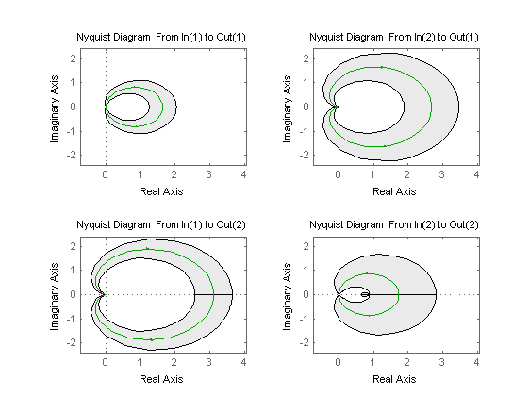
Robust Control Configuration Selection
Consider the previous example for which an off-diagonal decentralized controller was suggested.
Model uncertainty can be translated to uncertainty regions in the Nyquist diagram.
Question: Is the decision based on the nominal model still valid when uncertainty is considered?
Robust Control Configuration Selection aims at translating model uncertainty to uncertainty bounds on Interaction Measures.

Slide 16
Online Control Configuration Selection
Online Control Configuration Selection (CCS) aims at estimating Interaction Measures from process data.
Advantages of Onlince CCS:
Selecting configurations without the need of parametric models.
Posterior modeling efforts need to be placed only I/O chanels which were found to be significant.
Example:
Consider a process size 6x6. If we apply traditional CCS, then we need to create 6x6=36 SISO models. If a decentralized controller is later used, only 6 of those SISO models will actually be used for control design and 30 models would be discarded leading to superfluous work.
If on the contrary we use Online CCS, then we can determine from an experiment which I/O channels we will use for control and focus on modeling only those.

Slide 17
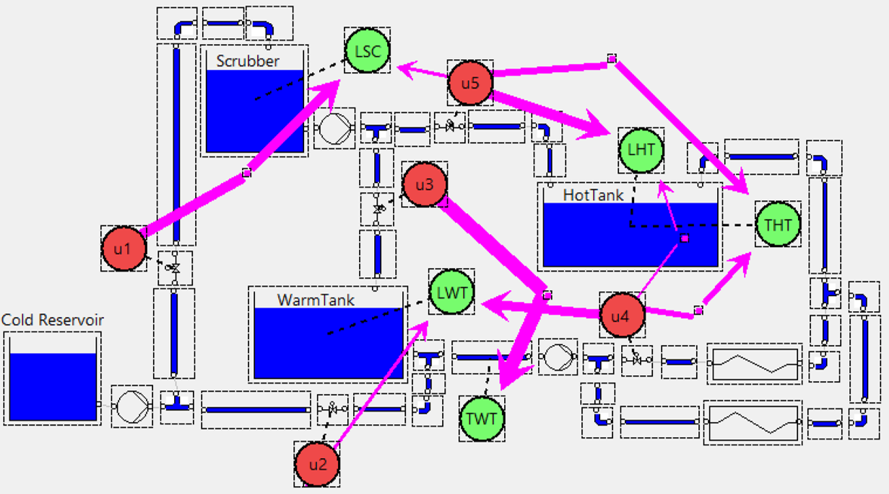
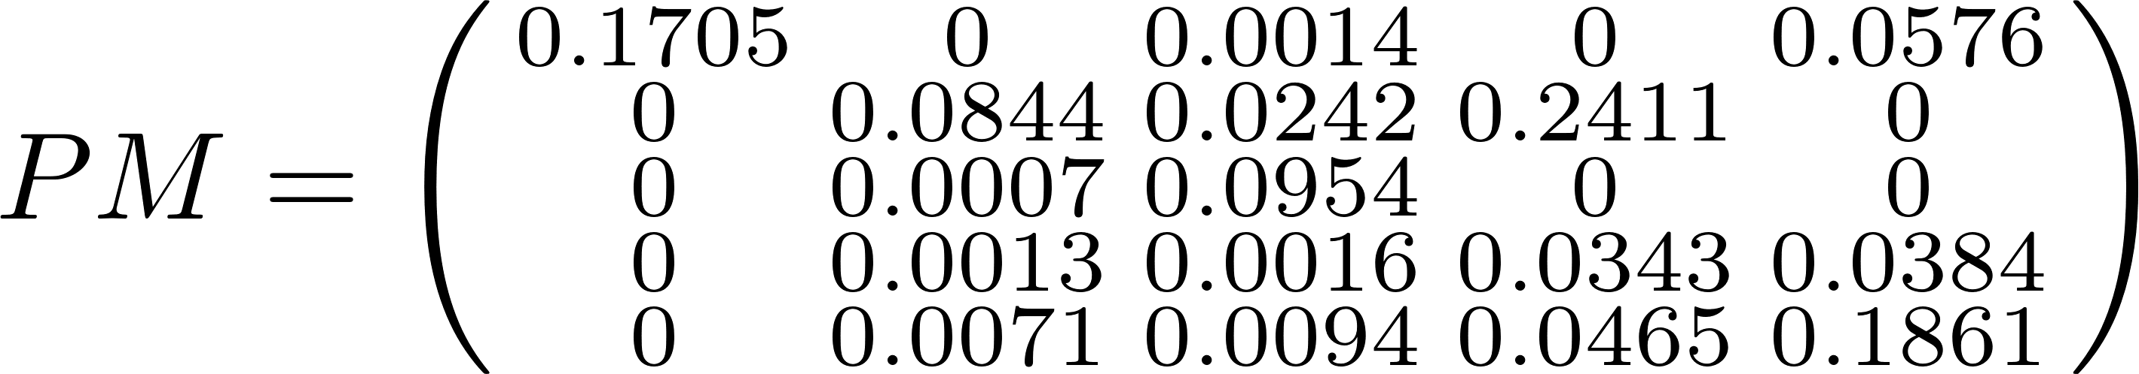
Automatic Control Configuration Selection
There are difficulties when using Interaction Measures to manually choose control configurations.
For the example below, you will find it difficult to pick the minimum number of IO channels with a contribution larger than 0.7, choosing at least one element per row and column.
Automatic CCS aims at formulating optimization schemes for the selection of control configurations using Interaction Measures.
u1 u2 u3 u4 u5
LSC
LWT
TWT
THT
LHT

Slide 18
Challenges in relation to Wireless sensor and actuator networks
“Removing cables saves installation and maintenance costs, but often the real gains lie in the radically different design approach that wireless solutions permit. “ K.H. Johansson (2006).
The new WSAN architectures lead to a potential for a dramatic change by being able to close local control loops over wireless multihop networks.
The fixed hierarchical centralized systems which are inherent of cabled systems can be restructured using WSAN for a more flexible and distributed system where computations and decision making can potentially be moved from dedicated computers to sensors and actuators.
Open questions are discussed in the paper on e.g. how to create CCS which can deal with:
Potential redeployment of sensors and actuators.
The opportunistic use of local measurements provided by in-situ sensors.
Communication imperfections brings additional control problems in WSAN.

Slide 19
Concluding Remarks

Slide 20
Concluding remarks
Control Configuration Selection (CCS) methods originated in the 60’s with interaction measures based on Relative Gains.
The number of publications on CCS has significantly increased since the introduction of the gramian-based Interaction Measures in 2000.
In the last decade, the CCS methods have branched in different classes of methods including the use of convex optimization
There is a research trend to extend existing CCS method to address issues like robustness, data-driven applications or the presence of non-linearities.
WSAN technologies open new opportunities due to their flexibility, but also present communication imperfection (e.g. delay, bandwidth, security risks) with significant effect in the control systems.

